Slide 1

CSC- 362 Computer Networks Week-10 Lecture:19 & 20
Prepared by:
Mr. Attique Ur Rehman

Slide 2
Internetworking

Slide 3
The Big Picture
You are here

Slide 4
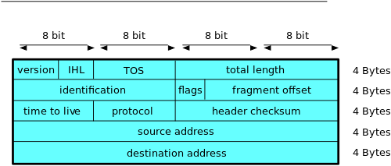
IPv4 Header
IPv4 has 14 fields and Header size is 20 Bytes

Slide 5
IPv4 Header
Version (4 bits)
Indicates the version of IP and is set to 4.
Internet Header Length (4 bits)
Indicates the number of 4-byte blocks in the IPv4 header.
Because an IPv4 header is a minimum of 20 bytes in size, the smallest value of the Internet Header Length (IHL) field is 5.
Type of Service (4 bits)
Indicates the desired service expected by this packet for delivery through routers across the IPv4 internetwork.
Total Length (16 bits)
Indicates the total length of the IPv4 packet (IPv4 header + IPv4 payload) and does not include link layer framing.

Slide 6
IPv4 Header
Identification (16 bits)
Identifies this specific IPv4 packet.
The Identification field is selected by the originating source of the IPv4 packet. If the IPv4 packet is fragmented, all of the fragments retain the Identification field value so that the destination node can group the fragments for reassembly.
Flags (3 bits)
Identifies flags for the fragmentation process.
There are two flags—one to indicate whether the IPv4 packet might be fragmented and another to indicate whether more fragments follow the current fragment.

Slide 7
IPv4 Header
IPv4 Header
Fragment Offset (13 bits)
Indicates the position of the fragment relative to the original IPv4 payload.
Time to Live ( 8 bits)
Indicate the maximum number of links on which an IPv4 packet can travel before being discarded.
Originally used as a time count with which an IPv4 router determined the length of time required (in seconds) to forward the IPv4 packet, decrementing the TTL accordingly. When the TTL equals 0,an ICMP Time Expired-TTL Expired in Transit message is sent to the source IPv4 address and the packet is discarded.
Protocol (8 bits)
Identifies the upper layer protocol.
For example, TCP uses a Protocol of 6, UDP uses a Protocol of 17, and ICMP uses a Protocol of 1.
The Protocol field is used to demultiplex an IPv4 packet to the upper layer protocol.

Slide 8
IPv4 Header
IPv4 Header
Header Checksum (16 Bits)
Provides a checksum on the IPv4 header only.
The IPv4 payload is not included in the checksum calculation as the IPv4 payload and usually contains its own checksum..
Source Address ( 32 bits)
Stores the IPv4 address of the originating host.
Destination Address (32 bits)
Stores the IPv4 address of the destination host.
Options (multiple of 32 bits)
Stores one or more IPv4 options.

Slide 9
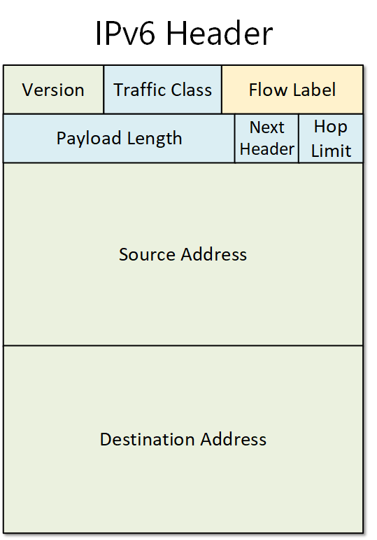
IPv6 Header
IPv6 Header
IPv6 has 8 fields and Header size is 40 Bytes

Slide 10
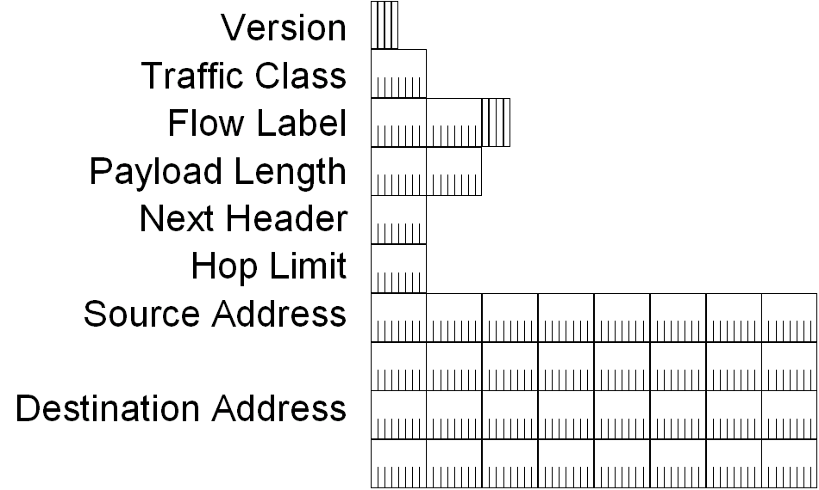
IPv6 Header
IPv6 Header

Slide 11
IPv6 Header Fields
IPv6 Header
Based on these rules, RFC 2460 defines the following IPv6 header fields:
Version (4 bits)
4 bits are used to indicate the version of IP and is set to 6
Traffic Class (8 bits)
Same function as the Type of Service field in the IPv4 header.
Flow Label (20 bits)
Identifies a flow and it is intended to enable the router to identify packets that should be treated in a similar way without the need for deep lookups within those packets.
Set by the source and should not be changed by routers along the path to destination.

Slide 12
IPv6 Header
Payload Length (16 bits)
With the header length fixed at 40 bytes, it is enough to indicate the length of the payload to determine the length of the entire packet.
Next Header (8 bits)
Indicates either the first extension header (if present) or the protocol in the upper layer PDU (such as TCP, UDP, or ICMPv6).
Hop Limit (8 bits)
In IPv6, the IPv4 TTL was appropriately renamed Hop Limit because it is a variable that is decremented at each hop, and it does not have a temporal dimension.
Source IPv6 Address (128 bits)
Stores the IPv6 address of the originating host.
Destination IPv6 Address (128 bits)
Stores the IPv6 address of the current destination host.

Slide 13
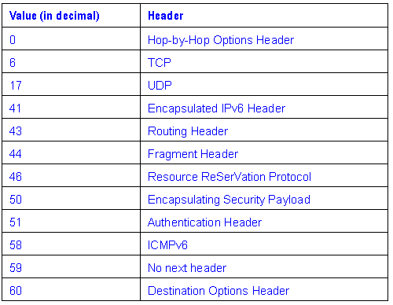
Values of the Next Header Field
IPv6 Header

Slide 14
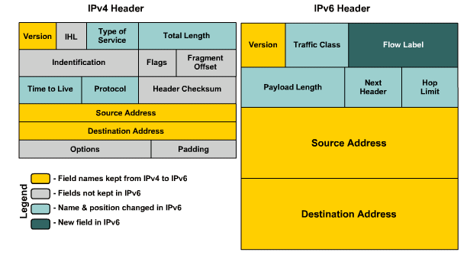
IPv4 vs IPv6 Header

Slide 15
IPv4 Field | IPv6 Field | IPv6 Field | Function
Time to Live | Hop Limit | Hop Limit | Both fields have the same function. They ensure that packets do not loop around the network indefinitely.
Protocol | Next Header | Next Header | Indicates the protocol being transported in the payload portion. In IPv6, it could also indicate the existence of an extension header.
Fields that exist in IPv4 and have been removed from IPv6
Internet Header Length |  | In IPv4, this field is used in cases when the header is variable length. It is not needed in IPv6, because the v6 header is a fixed-length - 40 bytes.
Identification, Flags, Fragment Offset |  | In IPv4, these fields are used when doing fragmentation. In IPv6, only the source of the packet is performing fragmentation using the Fragmentation extension header.

Slide 16
IPv4 Field | IPv6 Field | Function
Header Checksum | After many years of experience, the designers of IPv6 decided that this field is redundant and not necessary anymore because there are checksum fields in the upper layer protocols. | After many years of experience, the designers of IPv6 decided that this field is redundant and not necessary anymore because there are checksum fields in the upper layer protocols.
Options | Options are now handled using the extension headers in IPv6, so this field is not necessary. | Options are now handled using the extension headers in IPv6, so this field is not necessary.
Padding | Because IPv6 is fixed-sized, padding is not necessary. | Because IPv6 is fixed-sized, padding is not necessary.

Slide 17
IPv4 Field |  | IPv6 Field |  | Function
Fields that are new in IPv6 and do not exist in IPv4
 | Flow Label | Flow Label | A new field in IPv6 that is used for identifying that a packet is part of a sequence and has to be handled the same way as the entire traffic flow. | A new field in IPv6 that is used for identifying that a packet is part of a sequence and has to be handled the same way as the entire traffic flow.

